Slide 1
Inheritance ***(IMPORTANT!)***
9.1-9.2

Slide 2
Class Hierarchies
Inheritance is a relationship between a more general class, called a super class, and a more specialized class, called a sub class.
Ex: consider Animal as a class
Sub classes could include mammal, prime ape, human, silver back gorilla,
Ex: consider Vehicle as a class
sub classes could include cars, trucks, and
motorcycles
Cannot Assume car is a subclass; it must be explicitly stated
Hierarchy only works one way (Car is a vehicle, vehicle is not a car)

Slide 3
Is a?
When describing the sub class/super class relationship, think of it as an “IS A” relationship.
In the previous examples, a car IS A vehicles

Slide 4
Substitution Principle
This implication:
Consider a method
public void assignVehicle(Vehicle v)
Car myCar = new Car();
assignVehicle(myCar);
//these two lines are not part of this method header
//this is strange because the parameter that you are passing is not the same as the one you listed; the parameter listed is Vehicle, but you are using car; BUT THIS WORKS BECAUSE OF HIERARCHY; you could also pass motorcycle or truck through this parameter because you have established these subclasses with hierarchy, making the methods more flexible- THIS IS EXTREMELY USEFUL
//Keep in mind you cannot store a vehicle variable in a car
To establish the hierarchy you only need one word: extends

Slide 5
Why?
This principle allows methods and variables to be more versatile in many instances, such as the assignVehicle method, as that method can work for any vehicle.

Slide 6
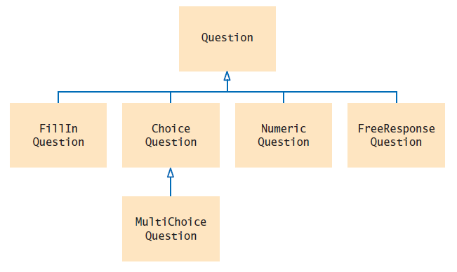
Class Hierarchy diagram
YOU WILL SEE DIAGRAMS SIMILAR TO THIS ON TESTS!!!!

Slide 7
inheritance
Any fields or methods in a super class are “inherited” by any sub class
If you consider a bankAccount class with methods deposit(int d) and withdrawal(int d)
Creating a sub class CheckingAccount or SavingsAccount, they would inherit those methods & fields, and they do not need to be recreated.

Slide 8
Syntax
To create a sub class the following is the Class header:
public class NewClass extends SuperClass
Example:
public class CheckingAccount extends BankAccount
public class Mammal extends Animal
public class Human extends Mammal

Slide 9
Try it
Create a class, BankAccount, with a field double balance and methods deposit(double amt) and withdrawal(double amt)
Fields get private
Methods are generally public
Create a sub class called SavingsAccount which extends BankAccount which has a constant double INT_RATE set to .25%, and a method addInterst() which calculates simple interest and adds it to the current balance.
Do we run into any issues? How can we solve them without changing access modifiers?

